Slide 1
Titanic - Who will survive?
By: Terry Shvartsman (114311609)

Slide 2

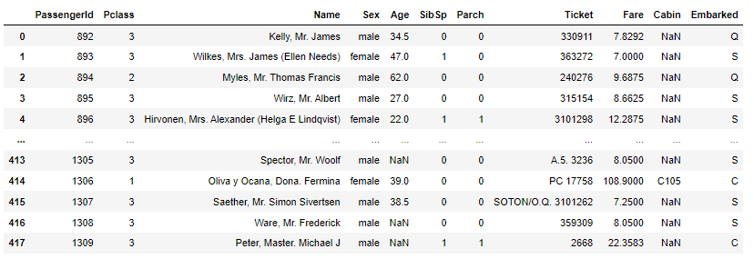
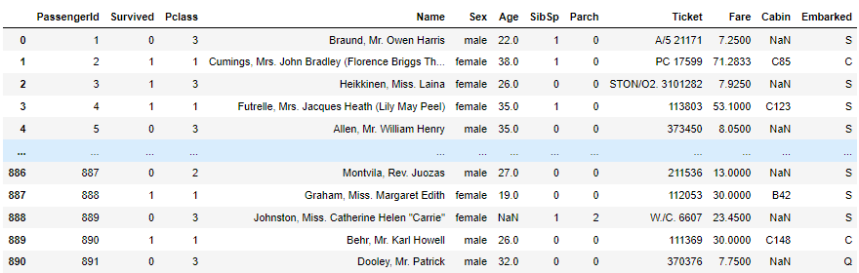
Original Data
Test
Train

Slide 3
Analyzing the Data (EDA)

Slide 4
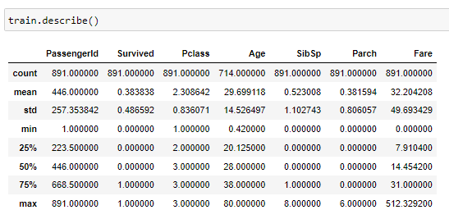
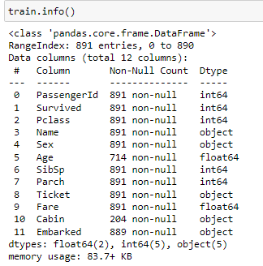
Preparing to Clean The Data
Using pandas functions, like the .describe() and .info() function, I was able to get an understanding of the spread of the data of each column. Determining the mean, median, q1, q3, min, and max is informative when considering factors like outliers and data distribution. In addition, the .info() function tells me how many non-null values, and hence how many null-values, each column has. This was useful in understanding which columns may need to be dropped, as well as which columns I needed to exercise caution with while mutating.

Slide 5
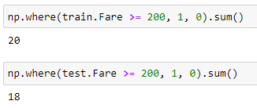
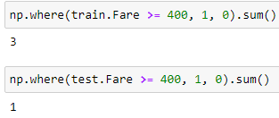

Cleaning the Data
Using the functions described before, I was able to use my understanding of the data to determine what data to remove. First, I determined that there were approximately 20 outliers in the “Fare” column with a fare of more than or equal to 200. However if I were to remove these rows, it would remove 18 rows, nearly 5%, of the rows in the test dataset. As such, using the .query() function, I removed the outliers than had a fare more than or equal to 400, which removed a minimal number of rows from the test data-set while also removing some odd rows from the training set. Furthermore, I determined that the columns “Passenger Id”, “Name”, “Ticket” (ticket number), were unnecessary columns and dropped them as well.

Slide 6
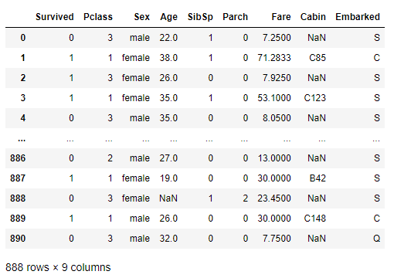
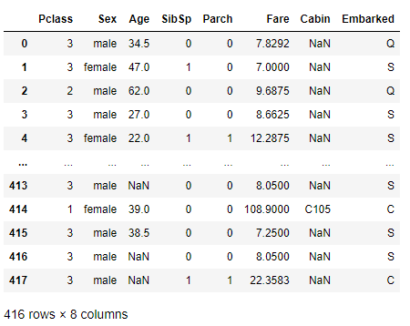
Data After Cleaning
Train
Test

Slide 7
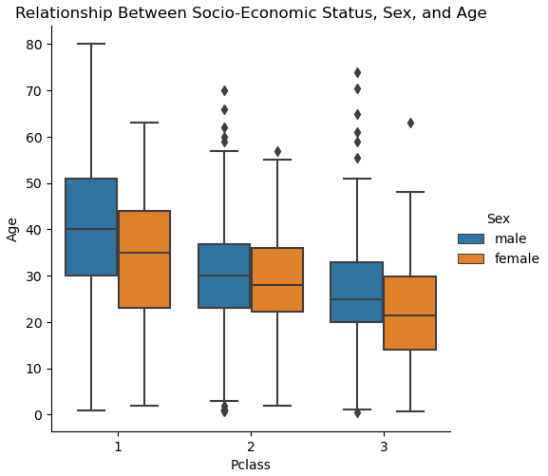
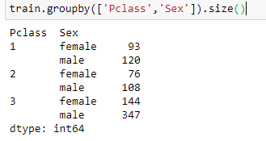
Analyzing Relationship between Socioeconomic Status and Other Features
There are a number of interesting observations that can be made through modeling the relationships between the features. It can be noticed that the median age decreases, for both men and women, as the “Pclass” increases. In other words, the higher the class, the higher the median age of the people. Additionally, as the catplot demonstrates, there are age outliers in Pclass 2 and 3, demonstrating a larger spread of ages in Pclass 1 compared to Pclass 2 and 3. This means that there were more very old and very young people in Pclass 1 than in 2 and 3. Furthermore, the catplot, along with the “Pclass vs Sex” table, demonstrates that there were more men than women in every Pclass, as well as that there is a massive jump in the difference between the number of males and females in the lowest Pclass compared to Pclass 1 and 2.

Slide 8
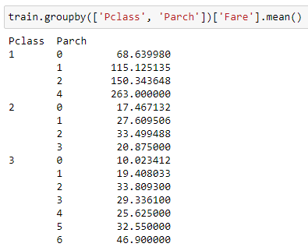
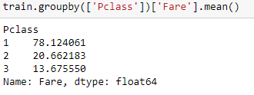
Analyzing Relationship between Socioeconomic Status and Other Features Continued
Finally, using the groupby function, I created a table that compared the average fare to the number of family members in each Pclass. Interestingly, Pclass 2 and 3 had no gaps in the number of family members, while Pclass 1 had no cases of 3 family members. Additionally, it can be noticed that Pclass 1 or 2 came with only three of four family members, while Pclass 3 had up to 6. Also, although somewhat obvious, I decided to compare the average fare by Pclass. As expected, the higher the class the higher the fare. The interesting thing, however, is how large of a difference the fare of Pclass 1 was from Pclass 2 and 3.

Slide 9
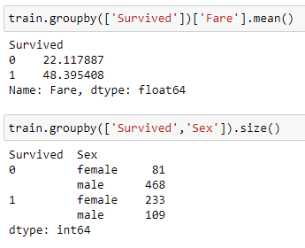
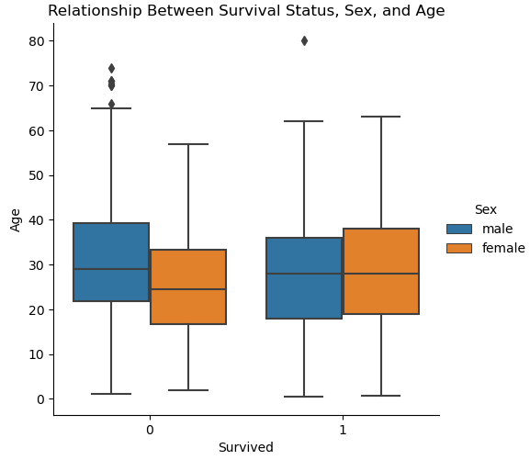
Analyzing Relationship between Survival Status and Other Features
There are a number of interesting observations between the survival status of passengers and their other features. Firstly, as demonstrated by the catplot and table, the vast majority of survivors were women, which makes sense since women and children were put onto the lifeboats first. However, it is interesting to consider that the ratio of women surviving out of total women is 233/314, which is almost 75%, while only 109/577, not even 20%, of men survived. Additionally, it can be noticed that the average fare paid by the survivors was significantly higher than those who died, even though the number of survivors was significantly less than the number of people that died. This demonstrates how the majority of survivors were from Pclass 1. As for age, it seems that the ages of both the survivors and the dead passengers was relatively distributed. However, as there are outliers in the males that died portion of the catplot, it can be deduced that more old people died than young people. This, again, makes sense since they put women and children on the lifeboats before adult males.

Slide 10
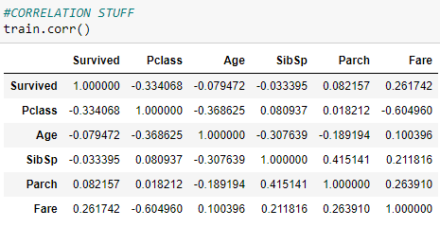
Correlation and Importance Analysis
Before doing any analysis, I hypothesized that the age, sex, and pclass will be the most important columns, and hence have the largest correlation (by magnitude). Unfortunately, as Sex is a non-numerical feature, I was unable to use the .corr() function to determine the correlation that it had. Instead, I used a catplot as shown below. Upon computing the correlation table, I was surprised to see how low of a correlation Pclass and Age has on Survived. The age had almost 0 correlation, the same as something I assumed insignificant like number of family members (Parch). Nevertheless, as expected, Pclass, and subsequently Fare, had the highest correlation with surviving. As such, Pclass and Fare are the most “important” features.

Slide 11

Extracting Information from Non-Numerical-Features
As mentioned in the slide above, finding the correlation between a non-numeric feature like Sex was impossible to do with the .corr() function. As such, in order to extract information from non-numeric features, you could use Seaborn’s plotting functions, such as pairplot and catplot, to model the information inside these non-numeric features. Additionally, it is possible to create tables using the groupby or sortby functions that display the non-numeric features in a numeric way. Finally, it is possible to use a pandas function called get_dummies() that converts the non-numeric feature into subcategories and then places a 1 or 0 depending on whether that subcategory is true or false. For instance, for the sex-dummies, it turned the Sex column into Male and Female and gave a checked whether the person was male. Thus, every male would get a 1, and every female a 0.
get_dummies
Cat-Plots

Slide 12
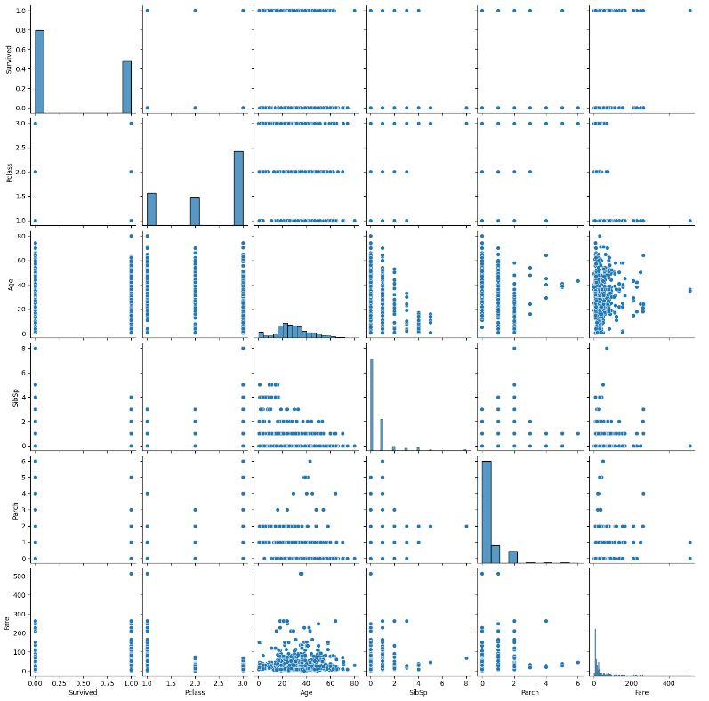
Extracting Information from Non-Numerical-Features Continued
Pair-Plot
Group-by

Slide 13
Modeling and Question Answering

Slide 14
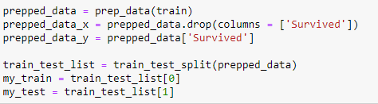
Splitting Data
The original data did not have the survived column in the test data-set, making it impossible to determine the accuracy of our model. As such, I split the original train data into two new sets called my_train, the new training data, and my_test, the new testing data.

Slide 15
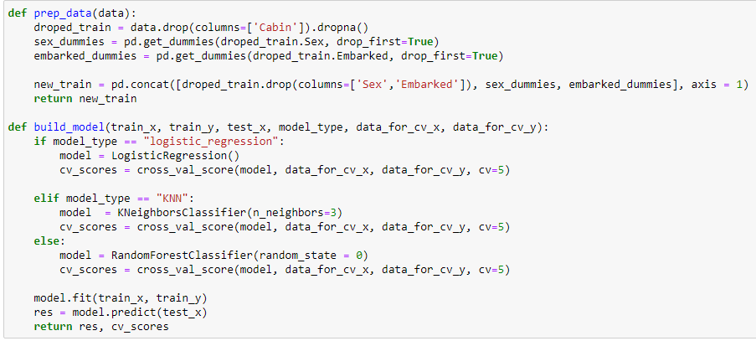
Functions Used

Slide 16

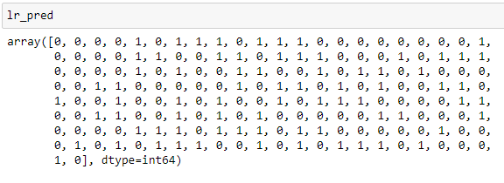
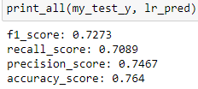
Model 1: Logistic Regression
The first model I used was the logistic regression model. Mathematically, the logistic regression model takes the input and transforms the data, using log, to create a line to represent the data. Using the created line, the model checks the difference between each input’s estimated value, as is derived by this line, and the actual value. The model takes the points with the smallest difference and uses that to predict future input values. By calculating the f1 value, recall value, precision value, and accuracy, the accuracy of the model is actually pretty high, since all the values are above 0.7.

Slide 17
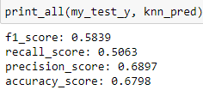
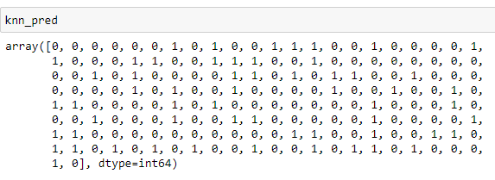
Model 2: K-Nearest-Neighbors
My second model is the K-nearest neighbors model. This model takes the inputted point and then the K nearest point to that point (the K is specified by the programmer; in this case I used 3). It then averages the output of the K inputs and uses that as a prediction. The f1, recall, precision, and accuracy score here was actually lower than the logistic regression. This is likely due to the knn model essentially cherry picking data, allowing a couple points to explain all the point, which is quite unreliable.

Slide 18
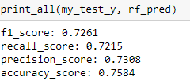
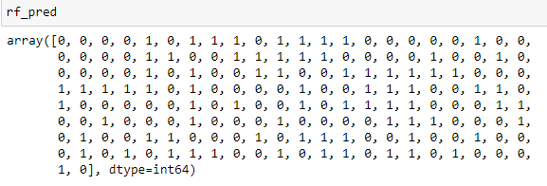
Model 3: Random Forest
My final model was the random forest model. This model takes a large number of decision trees, each trained on a different portion of the data, and uses the average of each decision tree’s output as a predictor for future inputs.This model worked quite well, with the f1, recall, precision, and accuracy score all being above 70. In fact, with a .75 accuracy score, this was the best out of the three models.

Slide 19
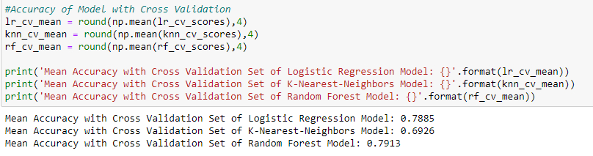
Re-Splitting and Cross Validation Set
In the build_model function, I calculated the cross validation score of each model using a sklearn built in function. It can be noticed that although the logistic regression and random forest models were already quite accurate, the cross validation set for both models had a higher mean accuracy. This means that the cross validation set actually improved these models by nearly 5%. However, even after creating a cross validation set, the KNN model’s accuracy didn’t change much. This is likely due to the unreliable nature of the model.

